Slide 1



MedSync
Elevating Healthcare Inventory Management through Seamless Synchronization.
Phase II
Final Review - II

Slide 2


Our Dedicated Team
Shreya Sinha
20BCE10030
Amar Kumar
20BCE10053
Supervisor - Mr. Ajeet Singh

Slide 3
Introduction
Medsync is an innovative project aimed at revolutionizing medical supply chain management. By leveraging advanced technology and strategic partnerships, Medsync ensures the seamless flow of crucial medical supplies, enhancing patient safety and healthcare efficiency. The project prioritizes supply chain resilience to withstand disruptions while also minimizing environmental impact and optimizing costs. Ultimately, Medsync aims to create a sustainable and reliable solution that benefits both healthcare providers and patients.

Slide 4
Problem Statement
"In today's dynamic business landscape, ensuring the seamless operation of supply chains is paramount for sustained business success, particularly in critical sectors like healthcare. However, the challenges of maintaining resilience in the face of disruptions while simultaneously reducing environmental impact and controlling costs present a complex dilemma for companies. Therefore, the problem statement revolves around developing a comprehensive strategy that balances supply chain resilience, environmental sustainability, and cost optimization, especially within medical contexts, to ensure uninterrupted operations, enhance patient safety, and contribute to a greener future.

Slide 5


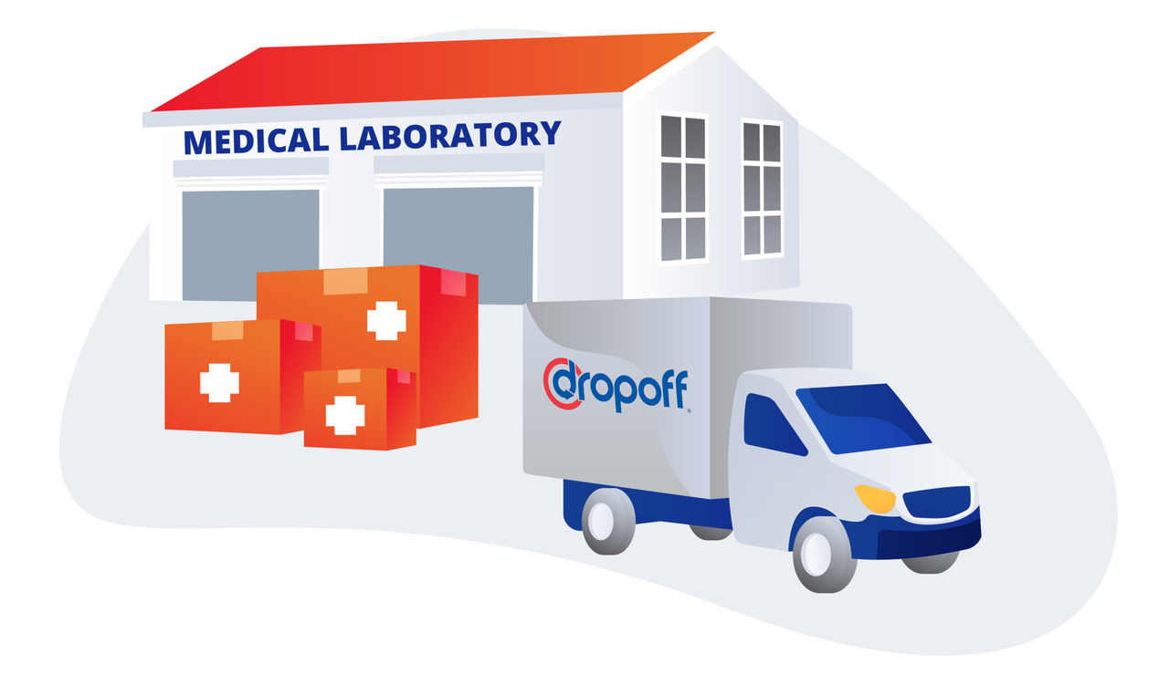

Objective
( Clarity and significance of the problem statement )
Supply chain resilience is essential for businesses to maintain operations and gain financial benefits.
Supply chain resilience is critical in medical contexts to ensure patient safety.
Companies must minimize their environmental impact, especially from transportation, which accounts for 40% of pollution.
The goal is to optimize costs while adhering to resilience and environmental considerations.
So, in simple terms, it's all about making sure businesses can keep running smoothly, in medical situations, while also being mindful of the environment and finding smart ways to save money.

Slide 6




Objective
( Feasibility and scope of the project )
Scope
Feasibility
Involves developing mathematical models for each product to determine optimal order quantities and timing.
The models will consider environmental impact, resilience, and cost minimization while ensuring robust demand satisfaction.
The project will be implemented in a specific medical context to evaluate its effectiveness and refine the approach.
Theoretically feasible, as the proposed methodology is based on established principles of optimization and modeling.
The availability of historical data and predictive algorithms makes it possible to forecast demand and optimize order decisions.
The project's success will hinge on its ability to achieve significant cost savings, environmental benefits, and improved supply chain resilience.

Slide 7



Research Findings
Hospital inventory needs are intricate and specific to individual patient requirements.
Fluctuations in inventory are pronounced in hospitals, leading to unexpected shortages.
Medical facilities face challenges in protecting sensitive inventory with limited shelf life.
Reference - https://medmgtservices.com/hospital-inventory-management-challenges/
1.
Overabundance of supplies and diverse procedures leads to tracking difficulties
Manual methods for managing expired, obsolete, and recalled products are prone to errors.
Limited data on supply usage increases the risk of stocking out, hence time-consuming manual checks.
Reference - https://www.cardinalhealth.com/CIMS_10Barriers_Effective_Inventory_Management.pdf
2.
Accurate and consistent capture of hospital inventory use equals achieving efficiency with new technology.
Higher inventory levels use up valuable hospital space, increased counting frequencies impact labor costs.
Joint role for clinicians and Inventory managers is important to ensure timely and effective patient care.
Reference - https://www.ncbi.nlm.nih.gov/pmc/articles/PMC8342273/
3.

Slide 8
Project Plan
01.
02.
03.
Implementation
1. Technology Integration and Unified Demand
2.Sustainable Transportation Adoption
Monitoring and Optimization
Continuous Monitoring and Improvement
Assess and Plan
Current State Analysis
2. Environmental Impact Assessment
3. Resilience and Sustainability Strategy
Conclusion
This condensed three-phase plan maintains a focus on critical objectives, allowing for a streamlined and efficient implementation of strategies to enhance supply chain resilience, minimize environmental impact, and optimize costs. Regular monitoring and adaptability remain key to sustained success.

Slide 9
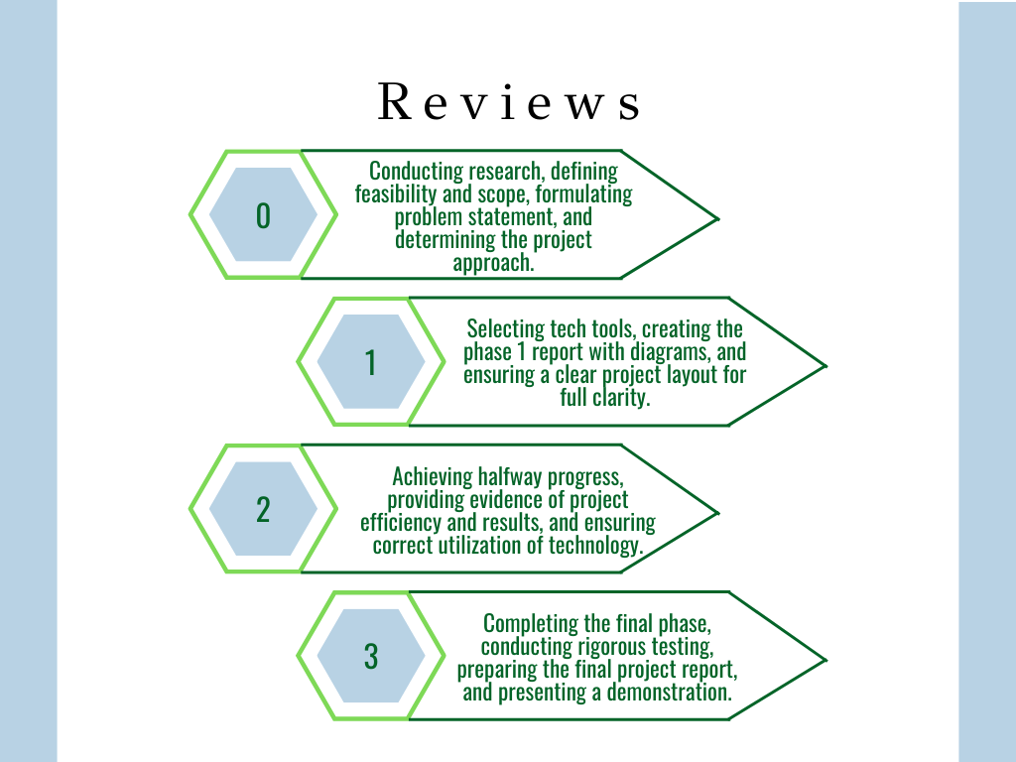

Project Timeline

Slide 10



Literature Review
Healthcare supply chain management plays a pivotal role in ensuring uninterrupted operations and mitigating potential life-threatening consequences.
Studies highlight the need for robust supply chains to guarantee uninterrupted access to essential medical supplies and services.
Significant environmental footprint of healthcare operations, with transportation is identified as a major contributor to pollution. Strategies to minimize this impact are of growing interest.
Balancing financial considerations with resilience and environmental impact is identified as a complex yet essential challenge.
The consolidation of orders among medical institutions is shown to reduce costs and enhance overall efficiency in the supply chain.
The effectiveness of mathematical models in optimizing various aspects of supply chain processes is well-documented.

Slide 11


Literature Review
Tailoring supply chain strategies for each product individually is a growing trend. Understanding and optimizing based on product characteristics can significantly enhance overall efficiency.
Studies emphasize the importance of considering specific providers and distribution centers, advocating for localized strategies to enhance efficiency and responsiveness in healthcare supply chains.
Practice of quantifying environmental impact as proportional to the number of orders.
Accurate demand prediction is highlighted as crucial for effective inventory planning. The integration of predictive analytics and purchase plans is recognized as a key factor in enhancing decision-making processes.
In conclusion, this literature review provides a foundation for the project, highlighting key considerations and challenges in healthcare supply chain management. The proposed project, with its focus on unified demand, mathematical modeling, and product-specific optimization, aligns with the evolving landscape of healthcare inventory management.

Slide 12
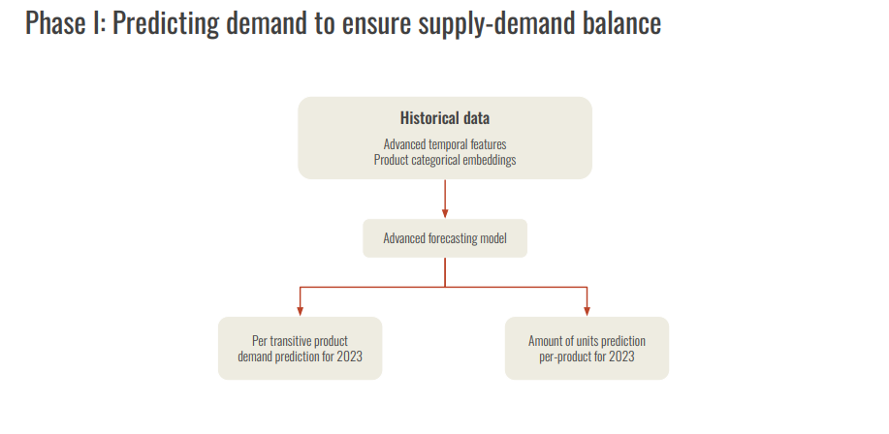
Workflow of the Project

Slide 13
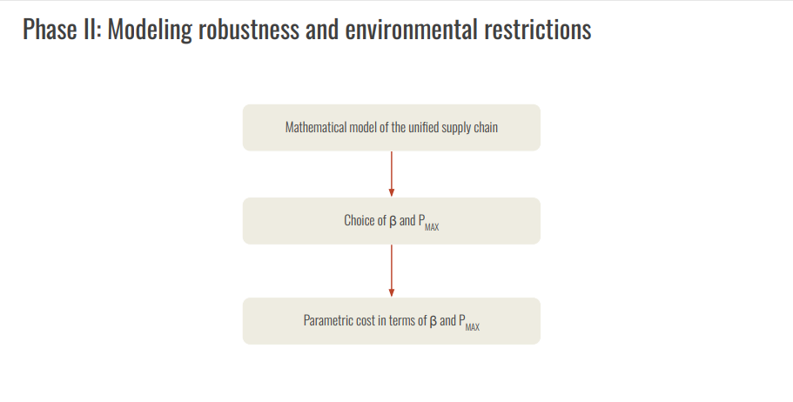

Slide 14
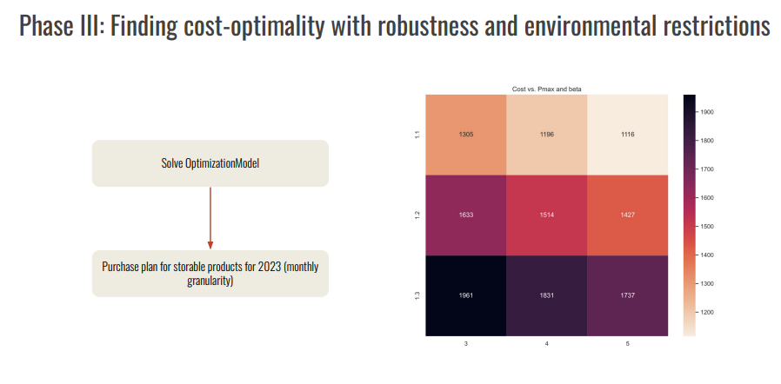

Slide 15
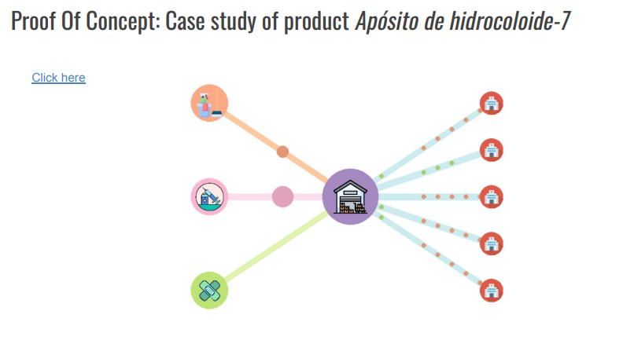

Slide 16




Methodology
A robust healthcare supply chain is essential for ensuring uninterrupted patient care and safety.
Inefficient supply chains can lead to shortages, delays, and poor response times to emergencies.
Optimizing healthcare supply chain management enhances efficiency, reduces costs, and improves patient care.
Streamlining the supply chain minimizes waste, mitigates shortages, and ensures timely access to critical medical resources.
Optimization is crucial during emergencies and enables healthcare providers to adapt to evolving demands.

Slide 17










Approach
The unified demand approach involves hospitals placing one collective order for a specific product, leveraging the associated economic benefits.
Each product is analyzed independently, and a model is developed to optimize the procurement process for each.
For a given product, a single provider and distribution center are considered, assuming a certain degree of locality within the region.
The objective is to minimize costs while adhering to environmental and resilience constraints.
Environmental impact is quantified based on the number of orders, and order decisions are made to ensure robust demand fulfillment within budget and storage limitations.

Slide 18
Tools used
Supply Chain Management Software: Implementing robust supply chain management software can help optimize inventory levels, track shipments, manage supplier relationships, and enable real-time visibility into the supply chain.
Risk Management Tools: Utilize risk management tools to identify, assess, and mitigate risks within the supply chain, including disruptions caused by natural disasters, geopolitical issues, or pandemics.
Data Analytics Platforms: Utilize data analytics platforms to analyze historical data, forecast demand, identify trends, and optimize supply chain processes for greater resilience and efficiency.

Slide 19
Implementation Details
Data Exploration:
● Identify and collect relevant datasets related to medical product storage and
distribution.
● Explore the datasets to understand their structure, variables, and relationships.
● Conduct initial descriptive statistics, such as summary statistics, histograms, and
correlation analysis, to gain insights into the data distribution and patterns.
2. Data Insight:
● Perform in-depth analysis to uncover meaningful insights and trends within the data.
● Utilize visualization techniques, such as scatter plots, line charts, and heatmaps, to
visualize relationships and patterns in the data.
● Identify key factors influencing medical product demand, inventory levels, and
distribution processes.
3. Data Cleaning:
● Identify and address missing values, outliers, and inconsistencies in the data.
● Impute missing values using appropriate techniques, such as mean imputation or
interpolation.

Slide 20

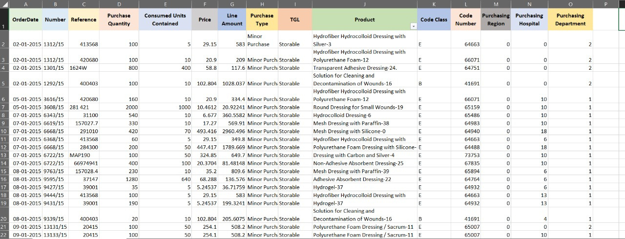

Dataset

Slide 21
Our dataset includes key columns that are crucial for our project “MedSync” :
P_ code - Serves as a unique identifier for streamlined tracking.
PRODUCTO - Provides detailed information for clear identification and categorization.
P_date - Enables trend analysis over time, optimizing ordering schedules.
N_Order - Offers precise order-specific details.
R_no - Provides additional layers of order-specific information.
N_product_purchased - Captures quantitative aspects for inventory level insights.
N_units - Offers insights into usage efficiency.
Cost - Addresses financial considerations for cost analysis.
Total_product_purchase - Facilitates budgetary control through total cost analysis.
Type_purchase - Provides information about the nature of the purchase.
H_code - Identifies the region of purchase.
Type_logistic - Describes the logistic distribution type of the product.

Slide 22


Dataset Usage
The dataset serves as a crucial tool in achieving our project objectives across various dimensions.
Firstly, it enables cost optimization by providing insights into procurement patterns (Purchase Date, Order Number/Year, Reference Number), allowing for tailored strategies for each medical product (Product Code, Product Description).
Secondly, it supports resilience enhancement by offering a comprehensive view of inventory levels (Number of Products purchased, Number of units that the Product contains) and aiding proactive order management (Purchase Date).
Thirdly, the dataset facilitates environmental responsibility by allowing us to quantify and minimize the environmental footprint associated with each order (Order Number/Year, Reference Number).
Collaborative efficiency is enhanced as the dataset enables a unified demand approach (Product Code, Order Number/Year), fostering collaboration among medical institutions.
Lastly, technological innovation is fueled by the dataset's role in crafting mathematical models and predictive analytics (Cost in Euros, Total cost of products purchased, Type of logistic distribution of product), paving the way for holistic solutions in healthcare supply chain management.

Slide 23
Data accuracy models to be used for testing Machine learning models
In our project Med Sync, we want to ensure that businesses in medical contexts can operate smoothly while also being environmentally friendly and cost-effective. We chose to use Tweedie loss and expense MAPE because they help us achieve these goals effectively.
Tweedie Loss: We use Tweedie loss because it's a good fit for our project's objectives. Tweedie loss is a type of loss function that is suitable for modeling insurance claims and other financial data, which often have characteristics like zero-inflation and overdispersion. By using Tweedie loss, we can better capture the distributional characteristics of our data, especially when dealing with count data (like the number of medical supplies) that might have excess zeros or varying levels of variability.

Slide 24
Expense MAPE (Mean Absolute Percentage Error): We chose to use expense MAPE as our evaluation metric because it provides a straightforward way to assess the accuracy of our model's predictions in terms of percentage. Since our goal is to optimize costs while maintaining resilience and minimizing environmental impact, expense MAPE allows us to measure how well our model performs in predicting expenses relative to the actual expenses incurred. By minimizing the MAPE, we can ensure that our predictions are close to the actual costs, helping businesses make informed decisions about supply chain management strategies that balance cost-effectiveness with resilience and environmental considerations.

Slide 25
Machine Models to be used
Temporal Fusion Transformers (TFTs) are cutting-edge predictive models tailored for time series data analysis, such as forecasting future trends. They integrate the Transformer architecture, renowned for its ability to grasp intricate temporal relationships within sequences, with mechanisms for assimilating diverse data streams and contextual information. In essence, TFTs act as highly sophisticated forecasting tools capable of delving into historical data, discerning patterns evolving over time, and providing precise predictions about forthcoming events. This makes TFTs particularly valuable in contexts like MedSync, where understanding and anticipating medical supply chain demands are crucial for ensuring seamless operations and patient care.
Boltzmann ensemble of GBMs it offers improved accuracy by combining predictions from multiple models, captures complex patterns in supply chain data, provides resilience to unexpected fluctuations, and offers flexibility in modeling various data types. This approach helps optimize inventory levels, forecast expenses, and enhance the resilience of the medical supply chain, benefiting both businesses and patients.

Slide 26
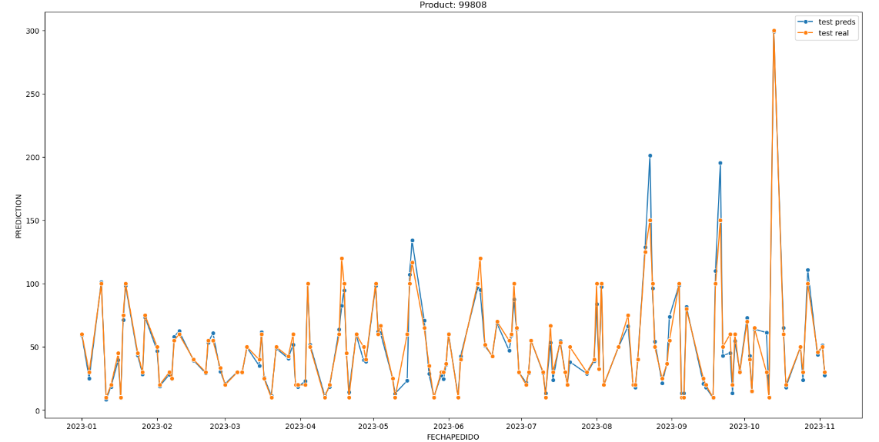
Screenshot of the Results

Slide 27
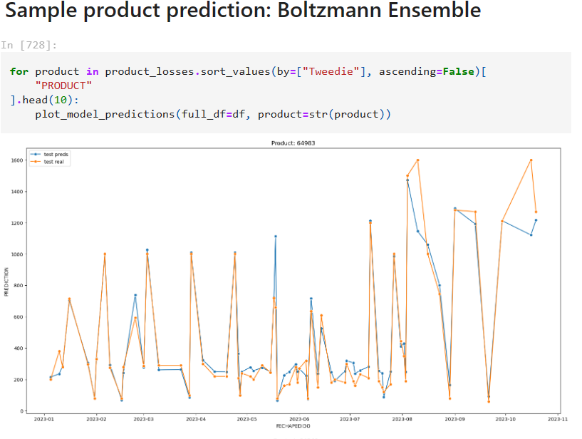

Slide 28
Final Outcome of the Project
MedSync delivers comprehensive insights into healthcare supply chain dynamics, offering a
nuanced understanding of material consumption patterns, procurement strategies, and supply
chain efficiency.
● Through advanced predictive modeling techniques, MedSync accurately forecasts product
purchases, empowering healthcare facilities to proactively manage inventory levels, reduce
stockouts, and optimize resource allocation.
● The platform generates tangible visualizations that not only showcase the predictive
capabilities of the models but also serve as effective communication tools for stakeholders,
facilitating decision-making and strategy development.
In the public community, MedSync's significance lies in its ability to inform decision-making processes, enabling healthcare organizations to make data-driven choices that lead to more efficient logistics and better resource utilization.
● By enhancing procurement strategies and supply chain management practices, MedSync contributes to cost-effectiveness in healthcare delivery, ultimately leading to improved patient care and outcomes.

Slide 29
Project Outcome and Public Impact
Outcome:
Comprehensive insights into healthcare supply chain dynamics.
Accurate predictive modeling for product purchase forecasting.
Tangible representation through visualizations of predictive capabilities.
Significance to Public Community:
Informed decision-making for efficient healthcare logistics.
Enhanced procurement strategies for better resource allocation.
Improved supply chain management leading to cost-effectiveness.

Slide 30
Project Outcome and Public Impact
Future Implications:
Implementation of optimized production plans for cost minimization.
Empowering stakeholders with actionable intelligence in healthcare logistics.
Aiding public health institutions in better resource utilization.

Slide 31
Project Module
Project Components
Supply Chain Management: Organizes how medical supplies move from makers to users.
Order Consolidation: Combines orders from different places to save money.
Resilience Planning: Prepares for unexpected problems in the supply chain.
Environmental Impact Assessment: Checks how our actions affect the environment.
Association between Components:
They work together to make sure orders are efficient, plans are flexible, and we're mindful of the environment.
Purpose
Efficiency: Helps medical facilities get supplies faster and cheaper.
Cost Reduction: Saves money by ordering smart and being ready for emergencies.
Environmental Responsibility: Cares about how our actions impact the environment.

Slide 32
Applicability in Societal Context
MedSync's applicability in real-world healthcare settings extends to hospitals, clinics, and other
medical facilities where efficient supply chain management is critical for patient care.
● It can be implemented in pharmaceutical companies and medical device manufacturers to
streamline inventory management, production planning, and distribution processes.
● Health ministries and government agencies can leverage MedSync to optimize procurement
strategies, ensure adequate stock levels of essential medical supplies, and respond effectively
to public health crises and emergencies.
● MedSync is beneficial for healthcare supply chain consultants and professionals seeking
data-driven insights to improve operational efficiency, reduce costs, and enhance service
quality.
● Medical research institutions can utilize MedSync to track and manage research materials,
laboratory supplies, and equipment, facilitating smooth workflow and research continuity.
● MedSync's predictive modeling capabilities make it valuable for healthcare policymakers and
decision-makers in designing robust healthcare infrastructure, resource allocation strategies,
and disaster preparedness plans.

Slide 33

Shreya Sinha
Her contribution in MEDSYNC project includes extensive research, successful project implementation, and thorough understanding of the utilized modules. This has led to tangible improvements in the medical supply chain, including enhanced efficiency, cost reduction, and a focus on environmental sustainability, ultimately benefiting patient safety and healthcare delivery. Her research efforts enriched the project with valuable insights, while her presentation skills effectively communicated complex information in a clear and engaging manner, leaving a lasting impression on our audience.
Amar Kumar
He played a crucial role in our project by extensively researching the methodologies employed. His focused efforts contributed to a thorough understanding of the project's methodological framework. Additionally, he actively participated in dataset research, providing valuable insights that influenced the project's overall direction. His dual contribution in methodology exploration and dataset research showcased his dedication to a well-rounded and informed project approach.
Contributions

Slide 34


References
https://medmgtservices.com/hospital-inventory-management-challenges/
https://www.cardinalhealth.com/CIMS_10Barriers_Effective_Inventory_Management.pdf
https://www.ncbi.nlm.nih.gov/pmc/articles/PMC8342273/

Slide 35
Summary
In conclusion, our collaborative scheme and mathematical model offer a promising approach to optimize the storage and distribution of medical products in a unified demand scenario. The consideration of environmental impact and resilience scores
in the optimization process aligns with the growing emphasis on sustainability and supply chain robustness

Slide 36
Future Scope
Here are the avenues for improvement and future research listed in short points:
1. Refinement of deep learning model for demand prediction:
● Explore advanced techniques like recurrent neural networks or attention mechanisms.
● Aim to enhance accuracy of demand predictions for better optimization.
2. Deeper exploration into storage optimization processes:
● Investigate advanced storage strategies such as dynamic allocation algorithms.
● Consider real-time inventory management for cost reduction and efficiency
improvement.
● Adapt storage strategies to dynamic changes in demand patterns for better scenario
adaptability.

Slide 37


MedSync

